Slide 1

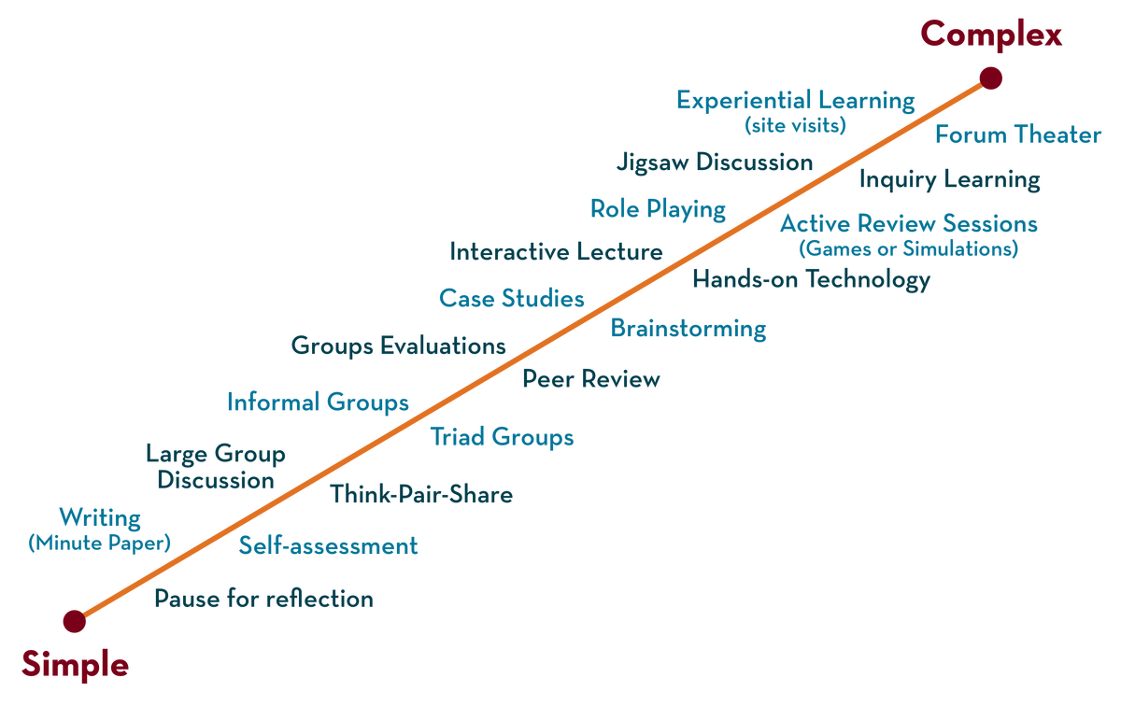
Network protocols & security
21CS2210
Topic:
NAT, Internet Control Protocols(ICMP), OSPF, BGP
Session - 17

Slide 3



AIM OF THE SESSION
To familiarize students with the basic concept of internet protocols and Interdomain and Intradomain Routing.
INSTRUCTIONAL OBJECTIVES
This Session is designed to:
Demonstrate the process of network address translation.
Describe the importance of ICMP in network diagnosis
List out the few routing protocols
Describe the routing protocols OSPF and BGP
LEARNING OUTCOMES
At the end of this session, you should be able to:
Demonstrate the OSPF routing protocol.
Demonstrate the BGP routing protocol.

Slide 4
NETWORK ADDRESS TRANSLATION

Slide 5
NETWORK ADDRESS TRANSLATION
32-bit IP address become scarce due to its limitation in the number of addresses.
Scenario can be like having IP address assigned dynamically, that is, when required we get an IP address from ISP, and when the session is terminated it can be allocated to some other.
But people working in business applications needs to access internet continuously.
NAT is used to reduce the no. of IP addresses that an organization needs.

Slide 6
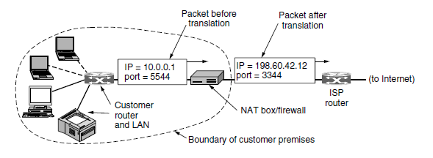
NETWORK ADDRESS TRANSLATION…
NAT Definition:
Assign each company a single IP address(Public) for internet traffic.
Within the company, every computer gets a unique IP address(Private) to manage intramural traffic.
Whenever a packet exits the company and goes to the ISP, an address translation(Private to Public) takes place.
A Network Address Translation (NAT) is the process of mapping an internet protocol (IP) address to another by changing the header of IP packets while in transit via a router. This helps to improve security and decrease the number of IP addresses an organization needs.

Slide 7
NETWORK ADDRESS TRANSLATION…
Private addresses:
10 . 0 . 0 . 0 - 10 . 255 . 255 . 255 / 8
172 . 16. 0. 0 – 172. 31 . 255 . 255 /12
192 . 168 .0 . 0 - 192 . 168 . 255 . 255 /16
Operation of NAT:
Initially the company had 4 computers and the IP addresses were provided by the ISP’s ( contiguous).
Now when the company has extended its employees and so its computers, in such case the contiguous in the IP address get lost and it is unable to get the IP address

Slide 8
NETWORK ADDRESS TRANSLATION
In such case NAT is used where a single IP address is going to identify the entire site or company with several private addresses.
Ex: SINGLE IP : 200.24.5.8
PRIVATE : 172.18.3.1
Case-1: when packets are sent from the site it uses 172.18.3.1, the NAT box converts the private address into original IP address (200.24.5.8)
Case-2: how NAT router identifies the actual address in the private site?

Slide 9
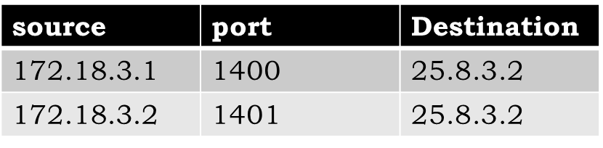
NETWORK ADDRESS TRANSLATION
NAT router maintains a table
When a reply comes from the destination to 200.24.5.8, it looks to the router table and finds the source.
Case-3: what if two source (Intramural) has the same destination address?
The solution in such case is port numbers at source side can be used to distinguish.
Source | destination
172.18.3.1 | x.y.z.a
source | Destination
172.18.3.1 | 25.8.3.2
172.18.3.2 | 25.8.3.2

Slide 10
INTERNET PROTOCOLS

Slide 11
INTERNET PROTOCOLS
ICMP – INTERNET CONTROL MESSAGE PROTOCOL
OSPF – OPEN SHORTEST PATH FIRST PROTOCOL
BGP – BORDER GATEWAY PROTOCOL

Slide 12
ICMP- INTERNET CONTROL MESSAGE PROTOCOL
The Internet Control Message Protocol (ICMP) is a network layer protocol used by network devices to diagnose network communication issues.
ICMP is mainly used to determine whether or not data is reaching its intended destination in a timely manner.
The primary purpose of ICMP is for error reporting.

Slide 13
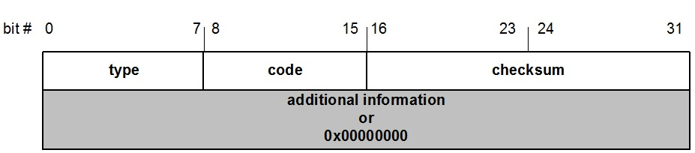
ICMP- MESSAGE FORMAT
4 byte header:
Type (1 byte): type of ICMP message
Code (1 byte): subtype of ICMP message
Checksum (2 bytes): similar to IP header checksum. Checksum is calculated over entire ICMP message
If there is no additional data, there are 4 bytes set to zero. → each ICMP messages is at least 8 bytes long

Slide 14
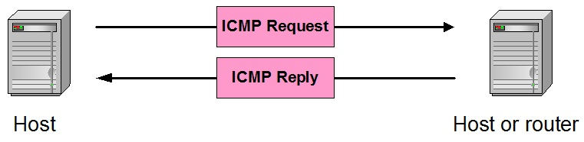
ICMP- MESSAGE
ICMP query:
Request sent by host to a router or host
Reply sent back to querying host
ICMP always reports error messages to the original source.

Slide 15
Frequent ICMP Error message
Type | Code | Description | Explanation
3 | 0–15 | Destination unreachable | Notification that an IP datagram could not be forwarded and was dropped. The code field contains an explanation.
5 | 0–3 | Redirect | Informs about an alternative route for the datagram and should result in a routing table update. The code field explains the reason for the route change.
11 | 0, 1 | Time exceeded | Sent when the TTL field has reached zero (Code 0) or when there is a timeout for the reassembly of segments (Code 1)
12 | 0, 1 | Parameter problem | Sent when the IP header is invalid (Code 0) or when an IP header option is missing (Code 1)

Slide 16
ICMP Error message – Subtypes
Code | Description | Reason for Sending
0 | Network Unreachable | No routing table entry is available for the destination network.
1 | Host Unreachable | Destination host should be directly reachable, but does not respond to ARP Requests.
2 | Protocol Unreachable | The protocol in the protocol field of the IP header is not supported at the destination.
3 | Port Unreachable | The transport protocol at the destination host cannot pass the datagram to an application.
4 | Fragmentation Needed and DF Bit Set | IP datagram must be fragmented, but the DF bit in the IP header is set.

Slide 17
OPEN SHORTEST PATH FIRST
(OSPF)

Slide 18
OSPF ( OPEN SHORTEST PATH FIRST)
Interior gateway routing protocol (IGRP)
Internet is made up of a large number of autonomous systems (AS).
Each AS is operated by a different organization and can use its own routing algorithm inside
For example, an AS has the internal networks of companies X, Y, and Z
A routing algorithm within an AS is called an interior gateway protocol
An algorithm for routing between autonomous systems (AS) is called an exterior gateway protocol.

Slide 19
OSPF
Link state technology
Developed by OSPF working group of IETF (RFC 1247)
OSPFv2 standard described in RFC2328
Designed for:
TCP/IP environment
Fast convergence
Variable-length subnet masks
Discontinuous subnets
Incremental updates
Route authentication
Runs on IP, Protocol 89

Slide 20
Features of OSPF
FEATURES OF OSPF
Provides authentication of routing messages
Enables load balancing by allowing traffic to be split evenly across routes with equal cost
Type-of-Service routing allows to setup different routes dependent on the TOS field
Supports subnetting
Supports multicasting
Allows hierarchical routing

Slide 21
OSPF
OSPF supports three kinds of connections and networks
Point-to-point lines between exactly two routers
Multi access networks with broadcasting
Multi access networks without broadcasting
Multi access network
It is one that can have multiple routers on it and can directly communicate with all others.

Slide 22
ROUTING USING OSPF
Routers maintain database with link state information, weights computed using link state, IP address etc.
This database in each router is updated by transmitting Link State Advertisements throughout the autonomous system
A shortest path tree is constructed by each router with itself as the root node and based on weights in the database.

Slide 23
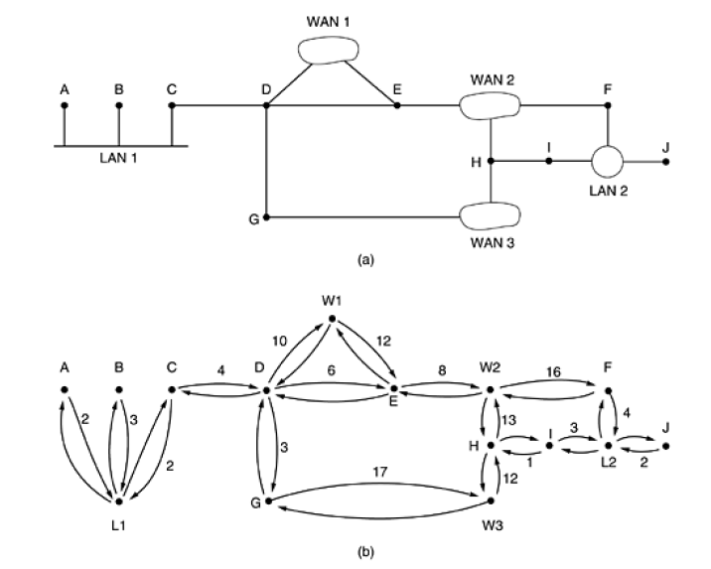

Slide 24
OSPF
Since AS’s in the internet are large, they are divided into areas
The topology of the area is not visible to outside world
Every AS’s has a backbone area called area 0. All areas are connected to back bone, possibly by tunnels, so it is possible to go from any area in the AS to any other area in the AS via the backbone.
Router that is connected to two or more areas is part of the back bone.
Within the area, routers follow link state database including the router connected to back bone.
A router that connects to two areas needs the database for both.

Slide 25
OSPF
During normal operation, types of routes are:
1. Intra area: within an area
2. Inter area: (i) source to back bone
(ii) go to destination across back bone
(iii) go to destination
3. Inter AS: Router types
i. Internal routers are wholly within one area.
ii. Area border routers connect two or more areas.
iii. Backbone routers are on the backbone.
iv. AS boundary routers talk to routers in other ASes.

Slide 26
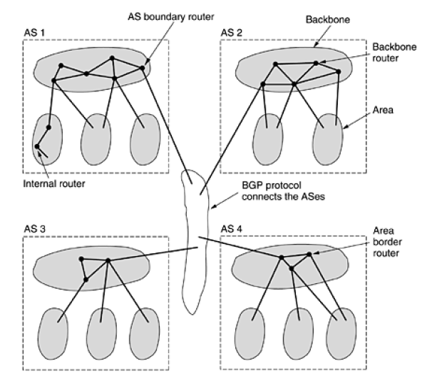
Autonomous Systems (ASes)

Slide 27
OSPF
When a router boots, it sends HELLO packet and multicasts
It starts to exchange information between adjacent routers by sending the following OSPF messages
1. DESIGNATED ROUTER- HELLO packet
2. LINK STATE UPDATE – provides sender costs to its neighbors
3. LINK STATE ACK – acknowledge link state update and each message has a sequence number to detect whether an incoming LINK STATE UPDATE is older or newer
4. DATABASE DESCRIPTION - gives the sequence numbers of all links state entries held by sender
5. LINK STATE REQUEST – request information from partner

Slide 28
BORDER GATEWAY PROTOCOL
(BGP)

Slide 29
BGP ( BORDER GATEWAY PROTOCOL)
Exterior gateway routing protocol
To move packets around the autonomous system
Constraints:
political
Security
Economic consideration
The objective is to manage the transit traffic
Types of networks:
1. STUB: one connection to BGP and cannot be used for traffic since only one connection
2. Multi connected network: used for traffic
3. Transit network: willing to handle third party packets

Slide 30
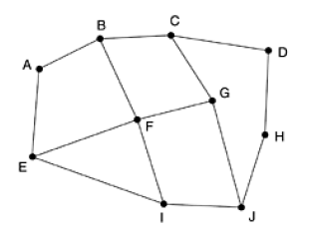
BGP
Uniqueness:
BGP maintains the path to the destination in addition to cost
Consider F’s routing table
The adjacent router provide their complete paths
F examines to see which is the best from below
(i) B C D (ii) G C D
(iii) I F G C D (iv) E F G C D
The protocol considers the distance as major factor
Solves the counter to infinity problems by taking other distances

Slide 31
SELF-ASSESSMENT QUESTIONS
Which of the following is considered to be the destination host before translation?
Inside local
Outside local
Inside global
Outside global
Open Shortest Path First (OSPF) is also called as _____________.
Error Control Protocol
Link State Protocol
Border Gateway Protocol
Distance Vector Protocol

Slide 32
TERMINAL QUESTIONS
Describe the process involved in NAT.
2. List out various routing protocols.
3. Explain the function of OSPF.
4. Discuss the need for BGP and its implementation.

Slide 33
REFERENCES FOR FURTHER LEARNING OF THE SESSION
Reference Books:
1. Data Communications and Networking, Behrouz A. Forouzan, 4th Edition, McGraw Hill.
2. Computer Networks, Tanenbaum, 6th Edition, Pearson.
Sites and Web links:
CISCO Academy
NPTEL, Computer Networks and Internet Protocols, Prof. Soumya Kanti Ghosh, Prof. Sandip Chakraborty IIT Kharagpur. (https://nptel.ac.in/courses/106105183)

Slide 34
THANK YOU
Team –Network Protocols and Security

